Slide 1
The Silver Screen APK
Movie Project

Slide 2
Introduction
Today date people love to watch movies online.
The Silver screen is a project where people will be watched their favorite movie without any advertisement and without spending their money.
The Silver Screen gets all movie details from IMDb and movie play links from Torrentz.
We also stored some good movies in the database.
People will search their favorite movie by name and also search by their favorite category like crime, superhero, sports, etc.

Slide 3
Problem definition And Objectives of Project
In today's world, after increasing covid case, cinema halls are closed and people are staying home.
peoples have lots of free time. that time they spend playing games and watching movies and web series.
According to Netflix after the first lockdown heavy traffic increased on their website.
peoples are taking more online subscriptions and spending money. but those who don't have money don't take this subscription.
That's why we creating this website. In this website freely available movies and web series.

Slide 4
Existing System and Disadvantages of Existing system
There are many existing systems like Netflix, Amazon, Hotstar, and other third-party websites like Katmoviehd, TheMoviesFlix
The Existing system like Netflix, Amazon, and Hotstar are charge prices monthly and yearly basis
And other third-party websites like KatmovieHd and TheMoviesFlix are contained lots of advertisements.

Slide 5
Proposed System
In The Silver Screen, we are providing movie details and a movie playing system.
The Silver Screen project does not charge any prices to play movies.
we also did not add any type of advertisement and our system is very clean.
That's why it is very easy to use.

Slide 6
Technology Requirements
For Backend -> Java, Spring Boot, Spring Security, JSOUP
For Frontend -> JavaScript and React Native
Database -> PostgreSQL

Slide 7
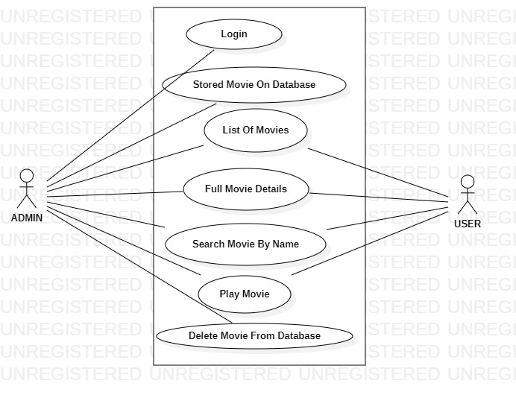
Use Case Diagram

Slide 8
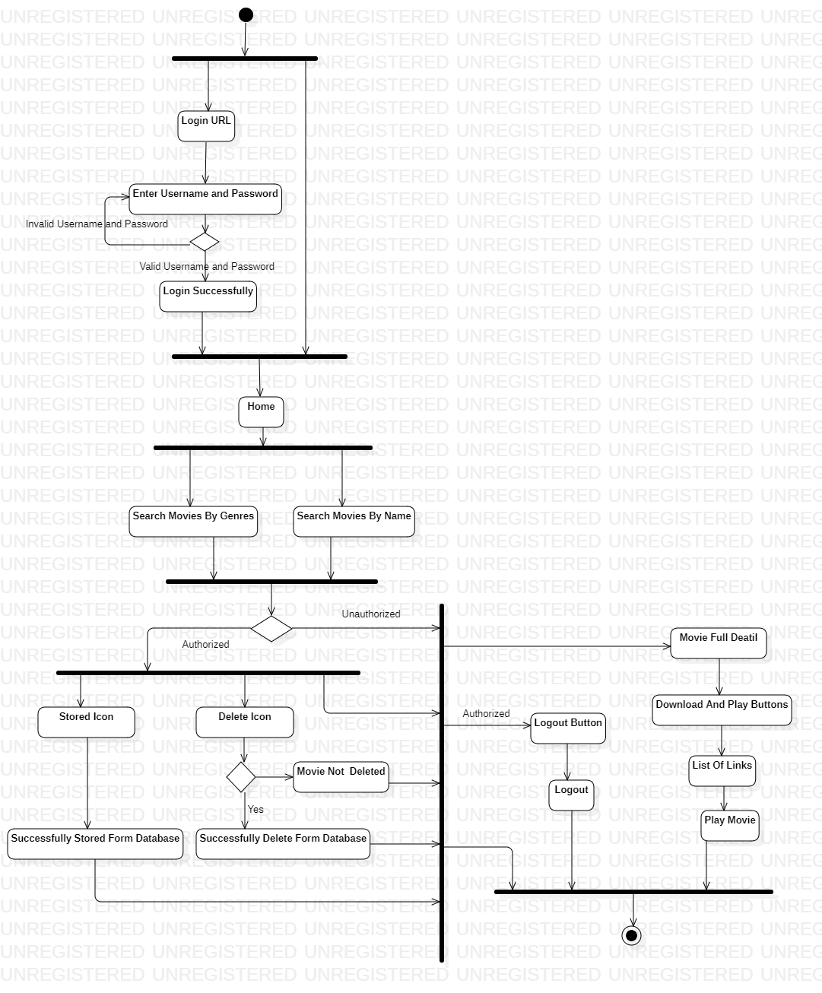
Activity Diagram

Slide 9
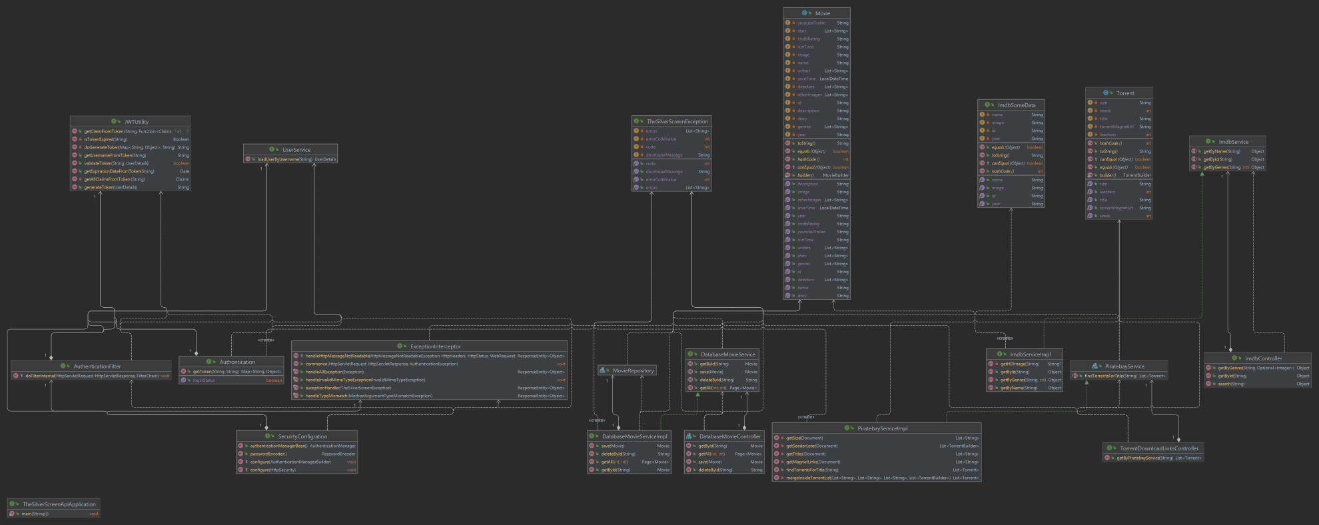
Class Diagram

Slide 10
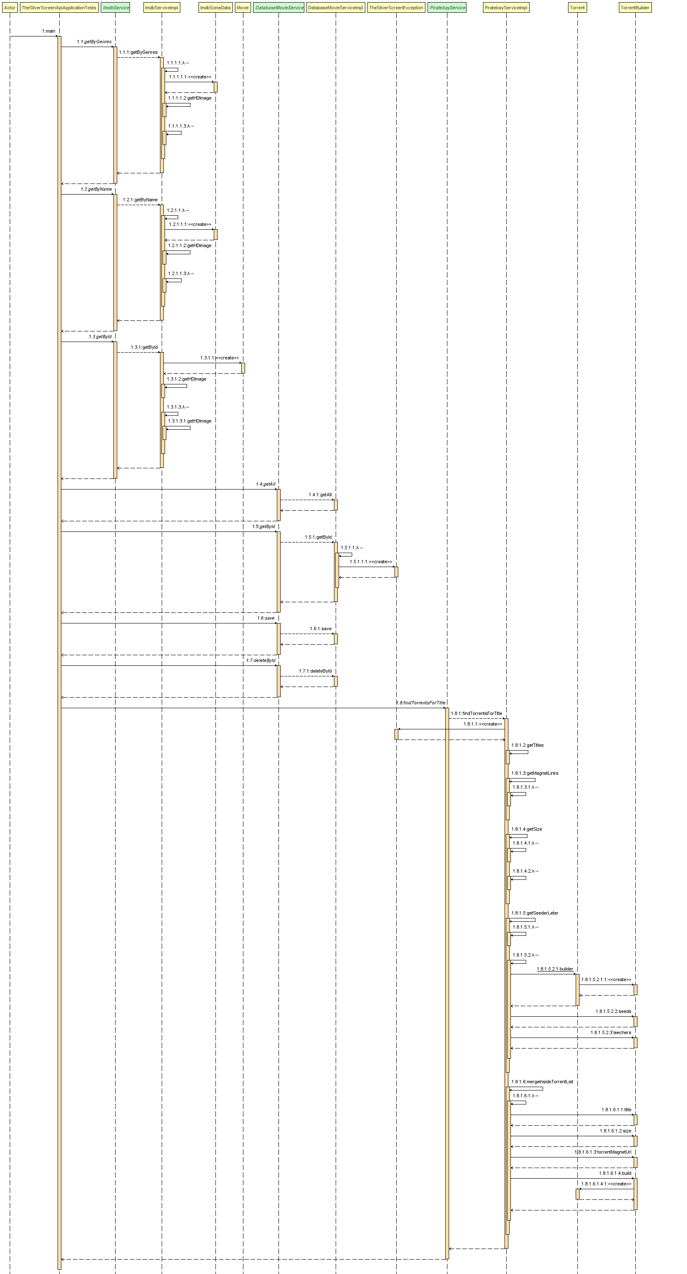
Sequence Diagram

Slide 11
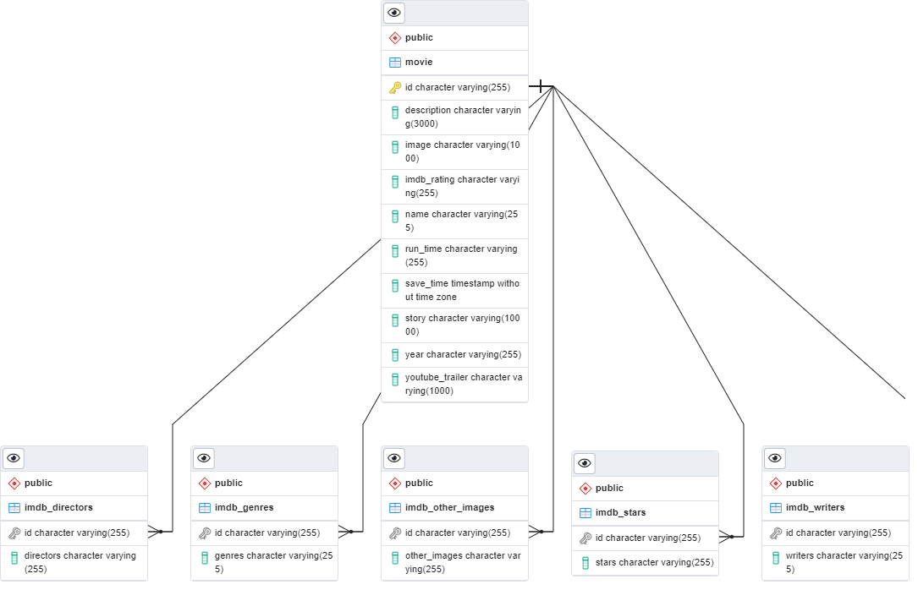
Database Diagram

Slide 12
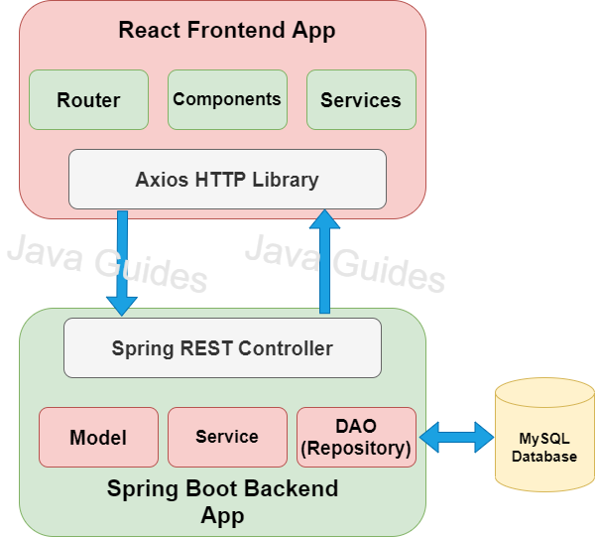
Interaction Between APK And Backend

Slide 13
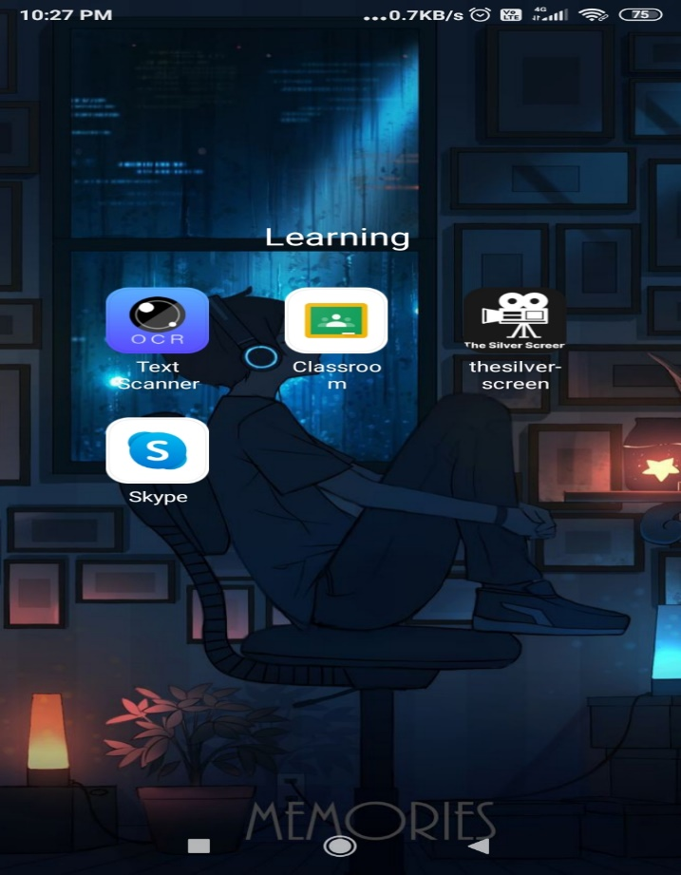
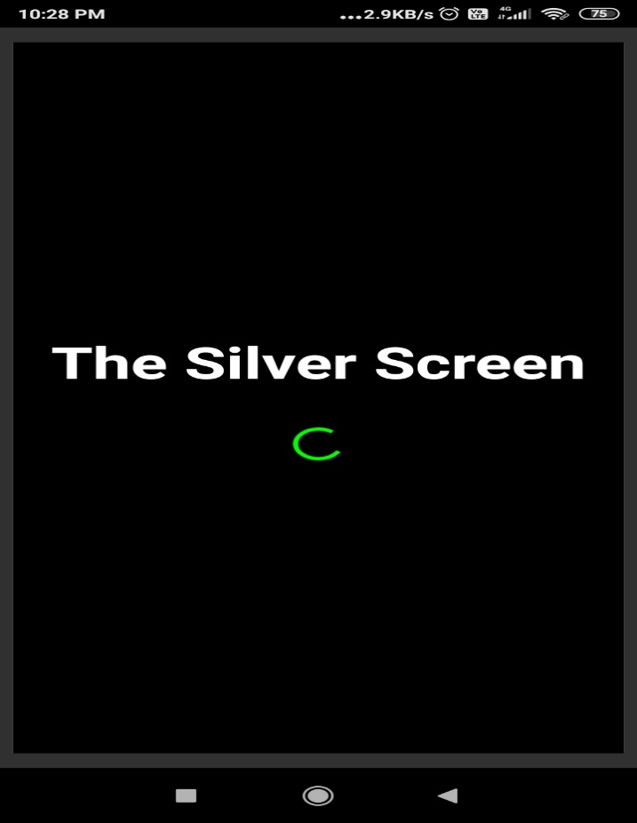
ICON
LOADING PAGE

Slide 14
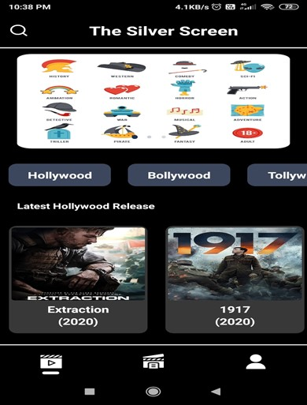
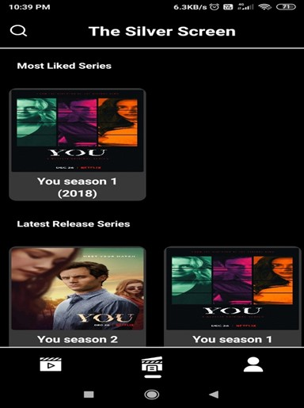
HOME PAGE
SERIES PAGE

Slide 15
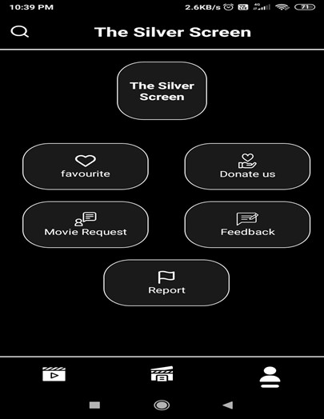
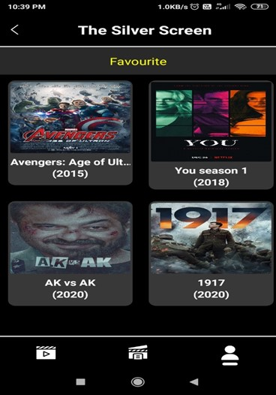
USER PAGE
AFTER CLICKING FAVOURITE ICON

Slide 16
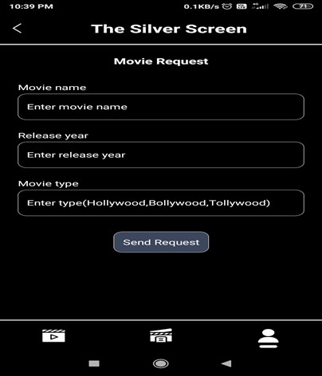
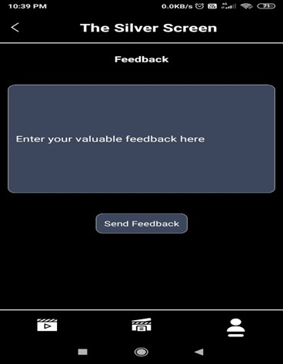
MOVIE REQUEST PAGE
FEEDBACK PAGE

Slide 17
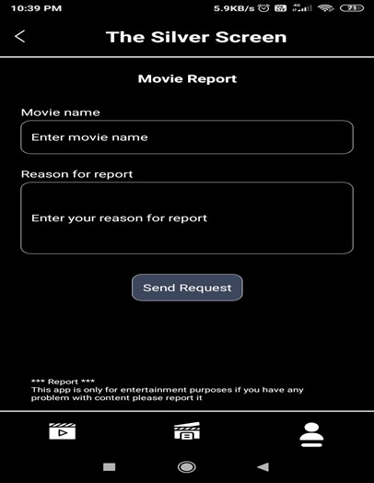
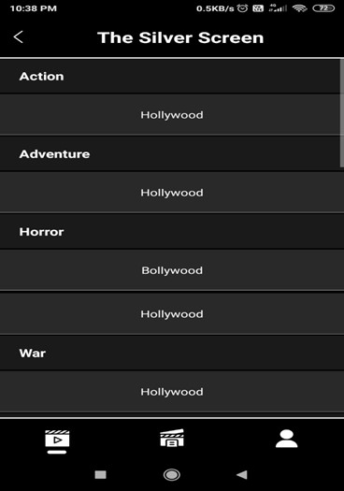
REPORT PAGE
AFTER CLICKING FIRST BANNER

Slide 18
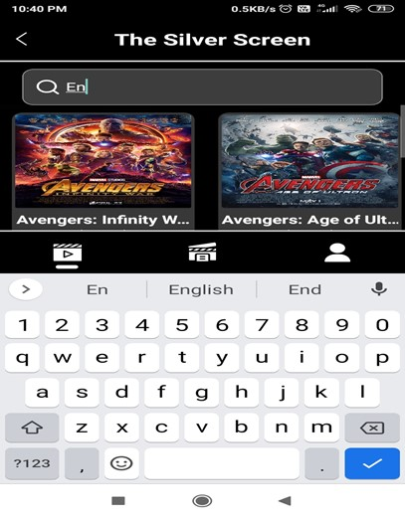
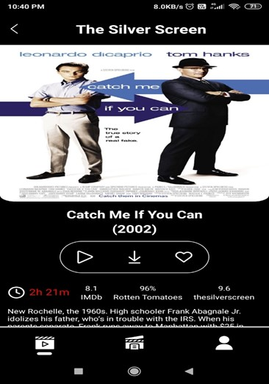
SEARCH BY NAME
FULL MOVIE DETAILS PAGE (1)

Slide 19
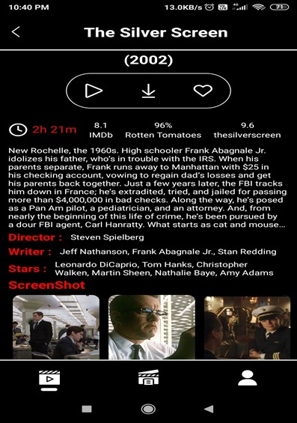
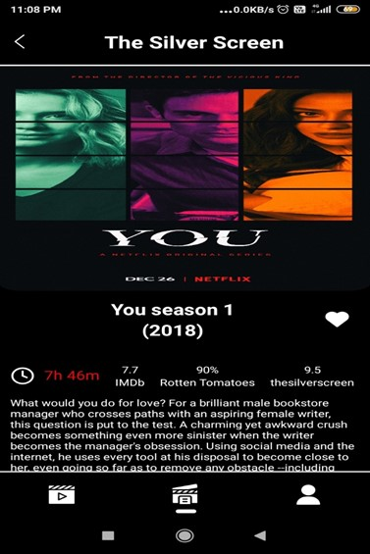
FULL MOVIE DETAILS PAGE (2)
FULL WEB SERIES DETAILS PAGE (1)

Slide 20
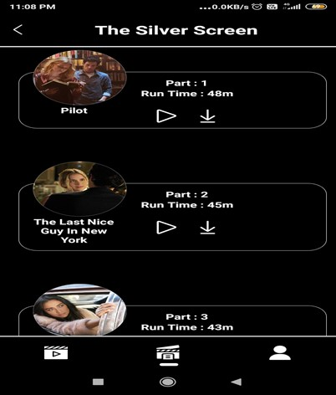
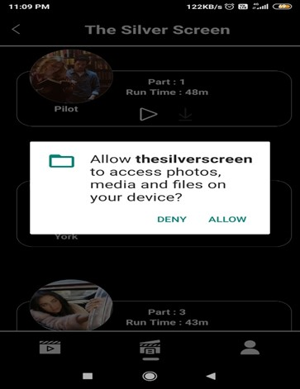
WEB SERIES PART DETAILS
AFTER CLICKING DOWNLOAD ICON

Slide 21
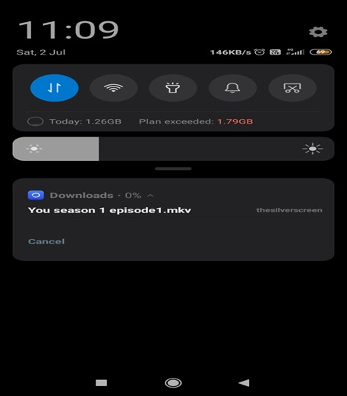
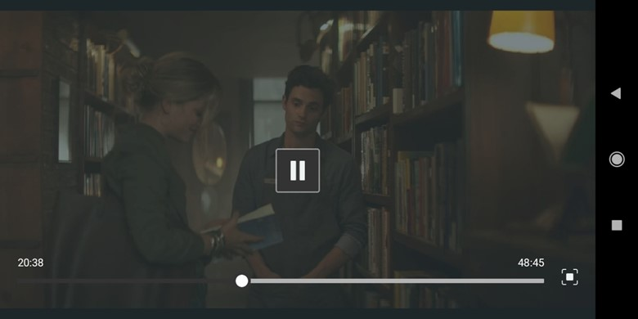
AFTER ALLOW DOWNLOAD
AFTER CLICKING PLAY BUTTON

Slide 22
Conclusion
The entire project has been developed and deployed as per the requirements specification
Backend Testing Using Juit5 and J-Meter
APK manual testing
Bug free
This UI design is easy to understand

Slide 23
Limitation And Future Enhancement
Links
Details
Player

Slide 24
Thank You

